Slide 1

Chapter 6
Database Design with the Rational Normalization Theory

Slide 2

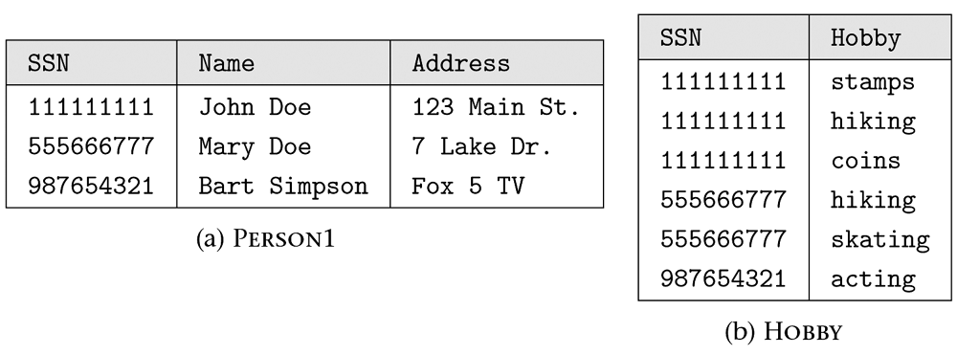
Figure 6.1 Decomposition of the PERSON relation shown in Figure 4.13.

Slide 3
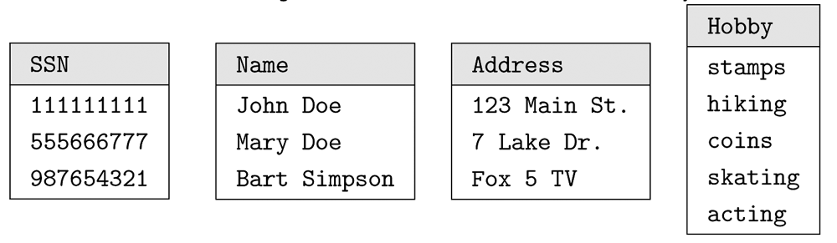
Figure 6.2 The “ultimate’’ decomposition.

Slide 4
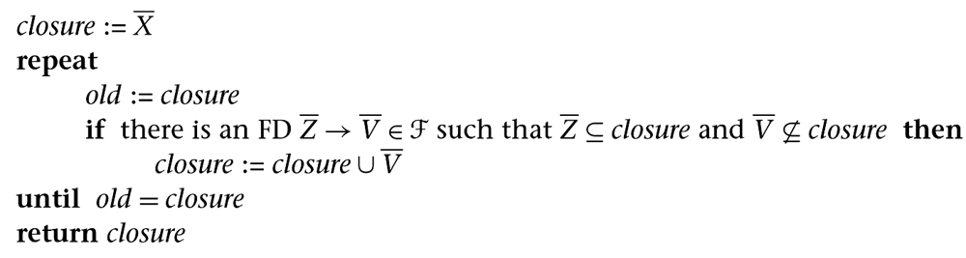
Figure 6.3 Computation of attribute closure X⁺₃.

Slide 5
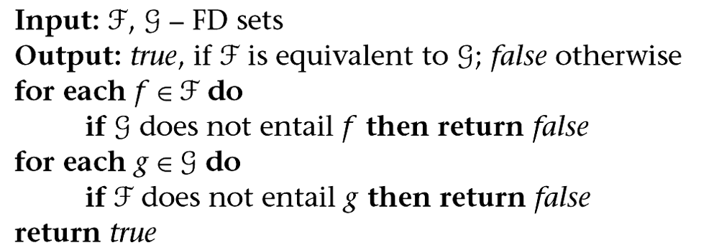
Figure 6.4 Testing equivalence of sets of FDs.

Slide 6
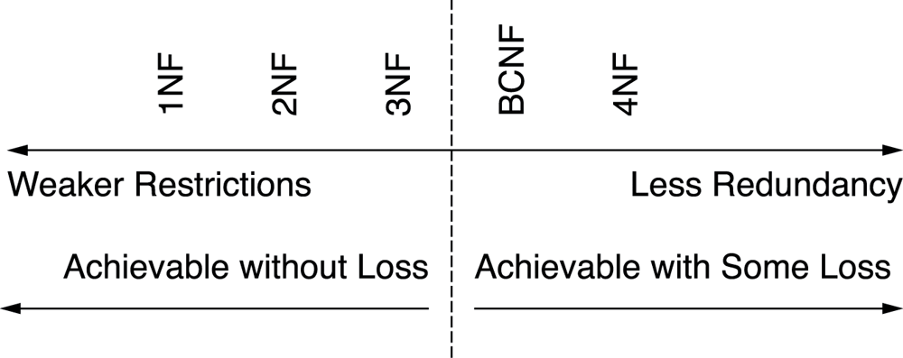
Figure 6.5 Relationship among normal forms.

Slide 7
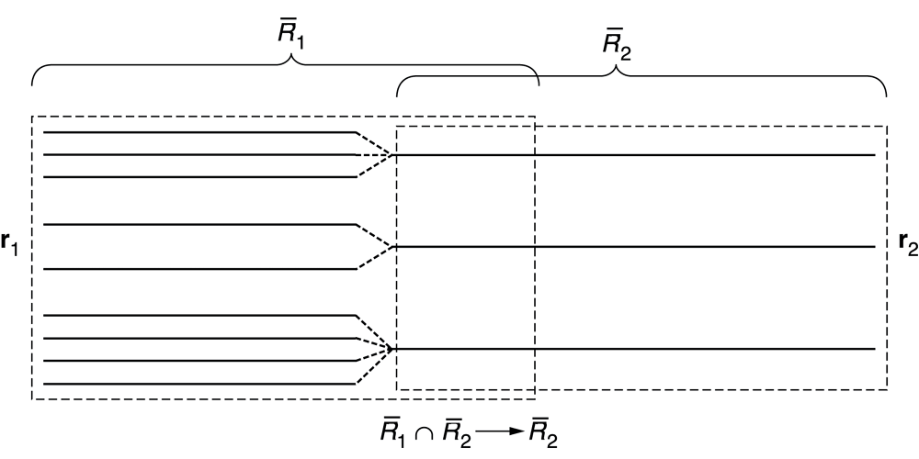
Figure 6.6 Tuple structure in a lossless binary decomposition: a row of r₁ combines with exactly one row of r₂.

Slide 8
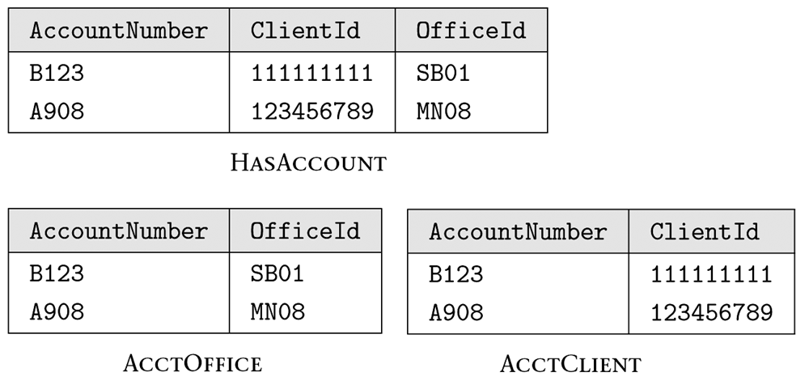
Figure 6.7 Decomposition of the HASACCOUNT relation.

Slide 9
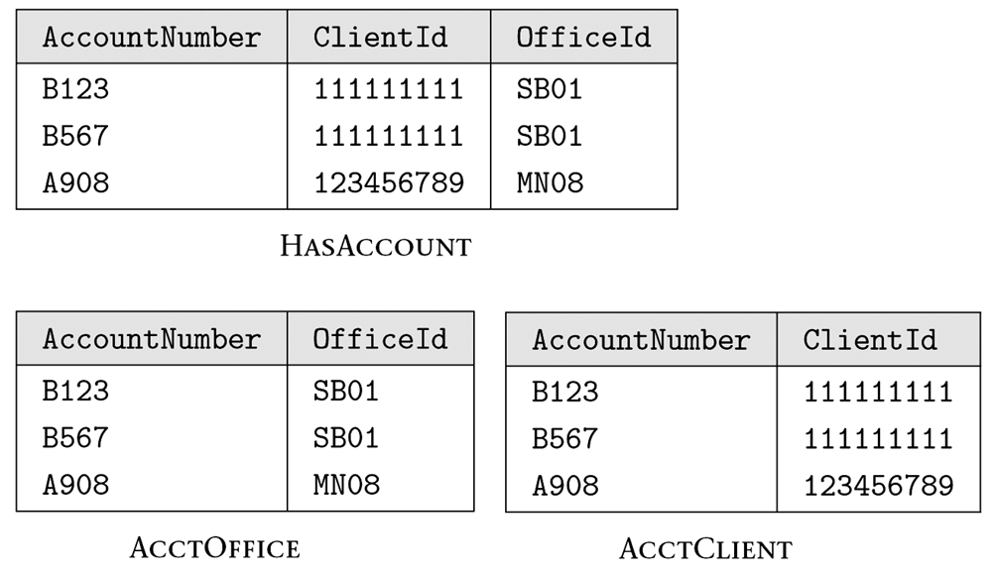
Figure 6.8 HASACCOUNT and its decomposition after the insertion of several rows.

Slide 10
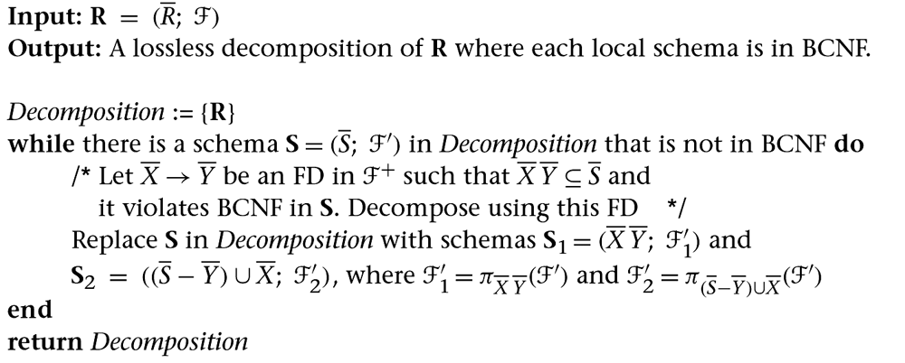
Figure 6.9 Lossless decomposition into BCNF.

Slide 11
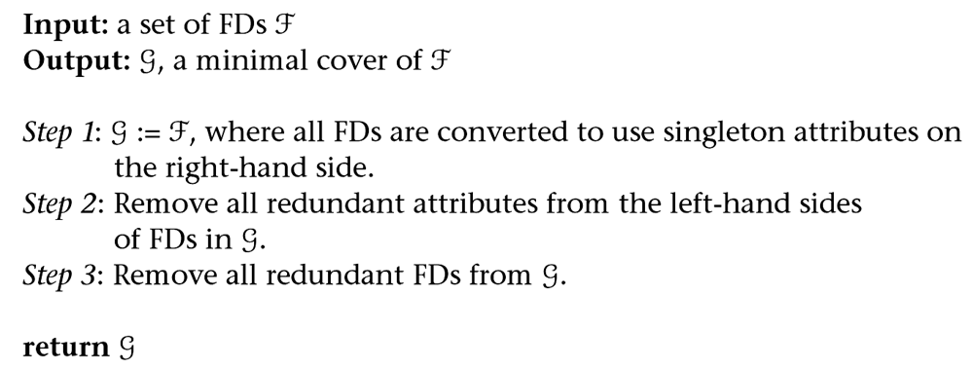
Figure 6.10 Computation of a minimal cover.

